Slide 1
Training session #1: What is Machine Learning?

Slide 2
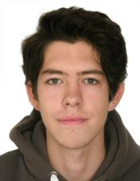
Who am I?
Bachelor’s degree in Applied Mathematics and Informatics (2017)
Master’s degree in Data Science (2019)
Conducted course on Deep Learning in HSE university. Materials of course: https://www.coursera.org/learn/intro-to-deep-learning
In Deloitte Moscow: April, 2018 – July, 2019
Work in Deloitte M.E since July, 2019
Fond of: Mathematics (Analysis, Linear Algebra, Probability theory, Discrete Mathematics), Data Science, Alogithms and Data Structures

Slide 3
Machine Learning training sessions: Sept 2019 - …:
Overview of Machine Learning world
Introduction to Python
Numpy package
Pandas package
Sklearn package
Keras package
Theoretical material on Machine Learning
Theoretical material on Deep Learning

Slide 4
Training session #1: What is Machine Learning?

Slide 5
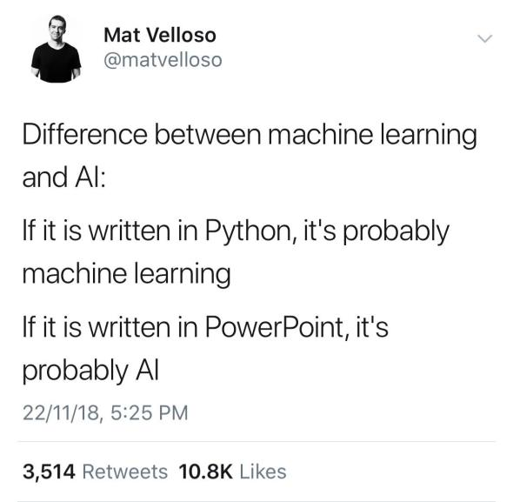

Slide 6
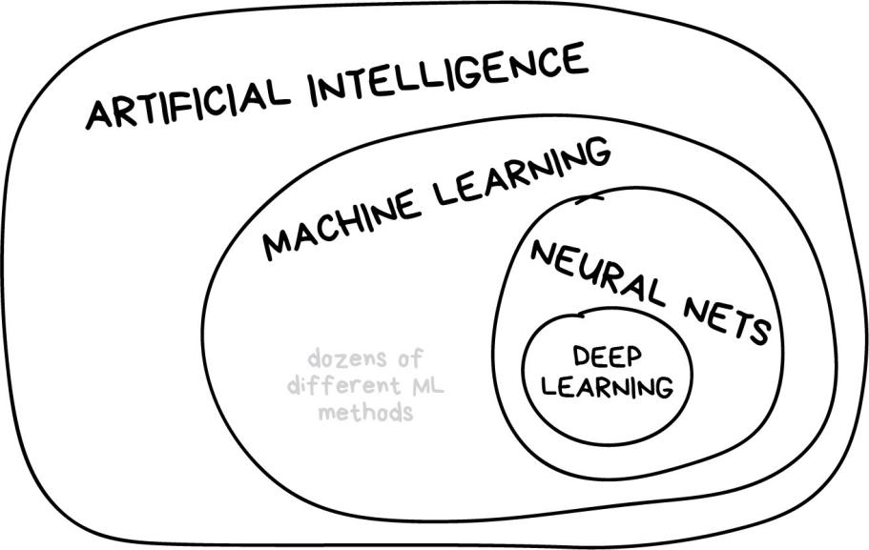
Training session #1: What is Machine Learning?

Slide 7
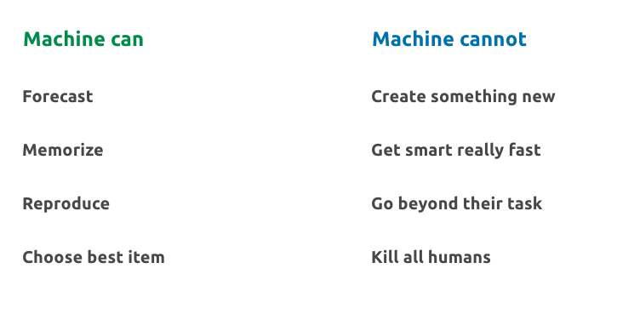
Training session #1: What is Machine Learning?

Slide 8

Why do we want machines to learn?

Slide 9
Simple Example:
Billy wants to buy a car. He went over dozens of ads and learned that:
New cars are around $20,000
Used year-old ones are $19,000
2-year old are $18,000 and so on
Billy, our brilliant analytic, starts seeing a pattern: so, the car price depends on its age and drops $1,000 every year. But won't get lower than $10,000.
=> Regression!

Slide 10
Another examples:
Rental prices in Dubai (whatever city)
Classification of images (cats and dogs)
Forecasting of Traffic jams
ATM withdrawal requests
Detect Spam emails
Predict if Taxi driver will take order or not
Expected delivery time (expected taxi travel time)
Credit scoring

Slide 11
Problem:
Cars have different manufacturing dates, dozens of options, technical condition, seasonal demand spikes, and god only knows how many more hidden factors.
An average Billy can't keep all that data in his head while calculating the price. Me too.
People are lazy => force machine to find patterns => birth of machine learning

Slide 12
Without all the AI-s**t, the only goal of machine learning is to predict results based on incoming data
Three components of machine learning:
1. Data
2. Features
3. Algorithms

Slide 13
Features (aka parameters or variables):
Examples:
car mileage, user's gender, stock price, word frequency in the text
When data stored in tables it's simple — features are column names

Slide 14
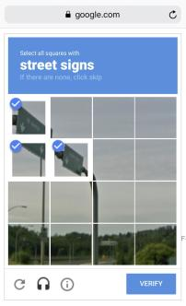
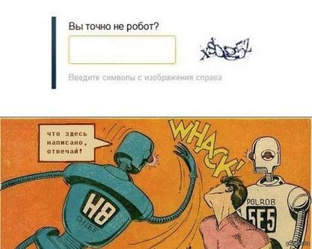
Data
- Want to predict something? Find data
Manual and automatic collection. Manual is more accurate, Automatic is cheaper
Cheap services https://www.mturk.com for manual data labeling
Somebody is very cunning and use their own customer to label data (ReCaptcha as well):
Are you robot?
Write symbols from the picture
Say what is written here?

Slide 15
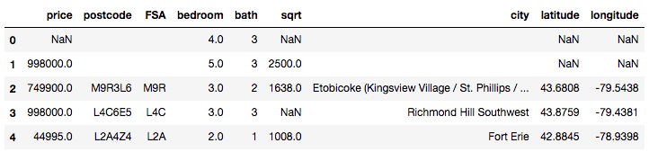
Example of dataset for Housing prices:

Slide 16
Algorithms
The method you choose affects the precision, performance, and size of the final model. For simple models - CPU, for hard models - GPU
Most important nuance:
If there is no dependency in the data even the best algorithm won't help (garbage in – garbage out)

Slide 17

The map of the machine learning world

Slide 18
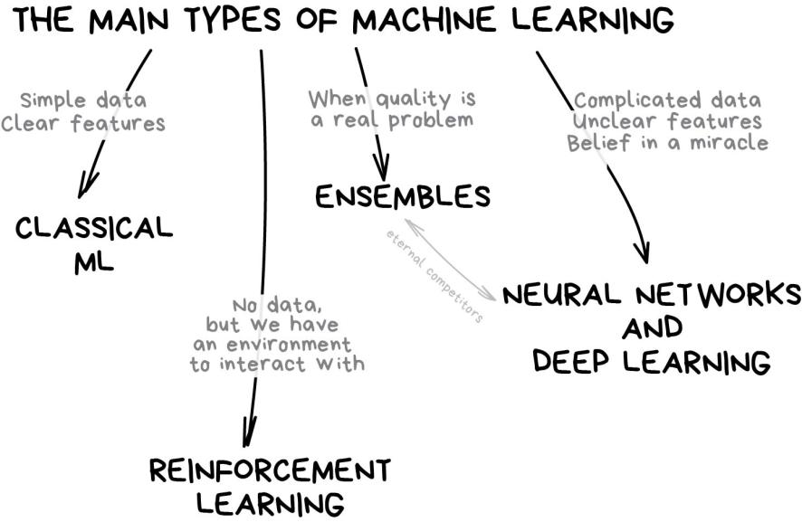
Training session #1: What is Machine Learning?

Slide 19
Classical Machine Learning
Came from pure statistics in the '50s
- When you see a list of articles to "read next"
- Prediction of traffic jams
- People You May Know in Facebook
- Email Spam
- Bank blocks your card at random gas station in the middle of nowhere

Slide 20
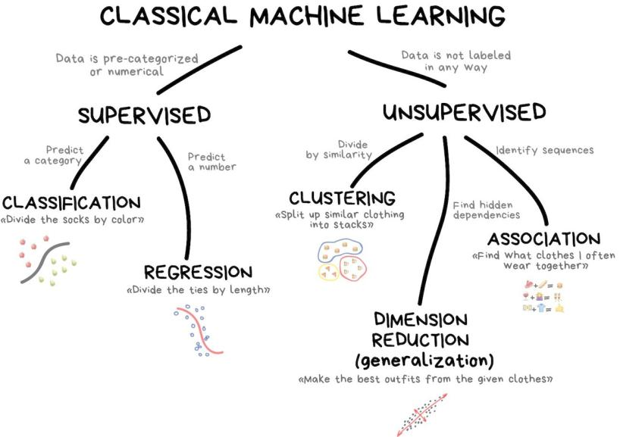

Slide 21
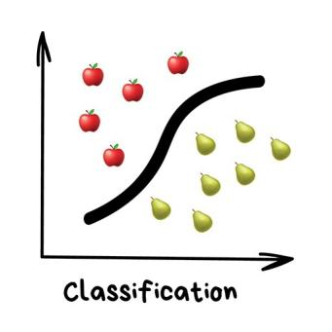
Classification: Splits objects based at one of the attributes known beforehand
Today used for: – Spam filtering – A search of similar documents – Recognition of handwritten characters and numbers – Fraud detection

Slide 22
Popular algorithms: Naive Bayes, Decision Tree, Logistic Regression, K-Nearest Neighbours, Support Vector Machine

Slide 23
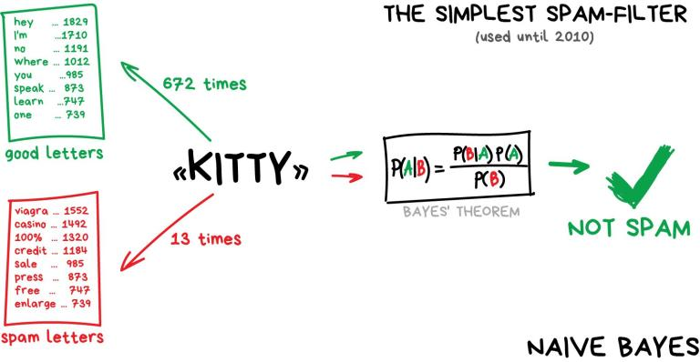
Idea of Naive Bayes classifier:
Pass it by: adding lots of "good" words at the end of the email - Bayesian poisoning.

Slide 24
Idea of Naive Bayes classifier:
Train model = gather the statistics:

Slide 25
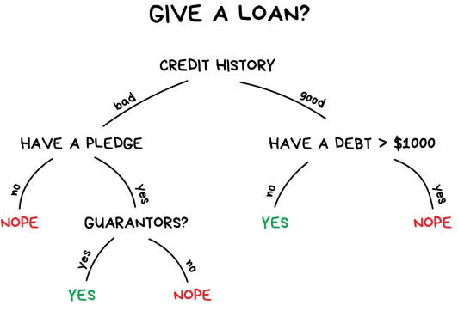
Idea of Decision Tree:
All the data automatically divided to yes/no questions. They could sound a bit weird from a human perspective, e.g., whether the creditor earns more than $128.12?

Slide 26
Idea of Decision Tree:
Train model = build this tree:

Slide 27

Decision Tree for Titanic:
"sibsp" is the number of spouses or siblings aboard
The figures under the leaves show the probability of survival and the percentage of observations in the leaf

Slide 28
Another examples of Decision Tree:
When you google something, that's precisely the bunch of dumb trees which are looking for a range of answers for you. Search engines love them because they're fast.

Slide 29
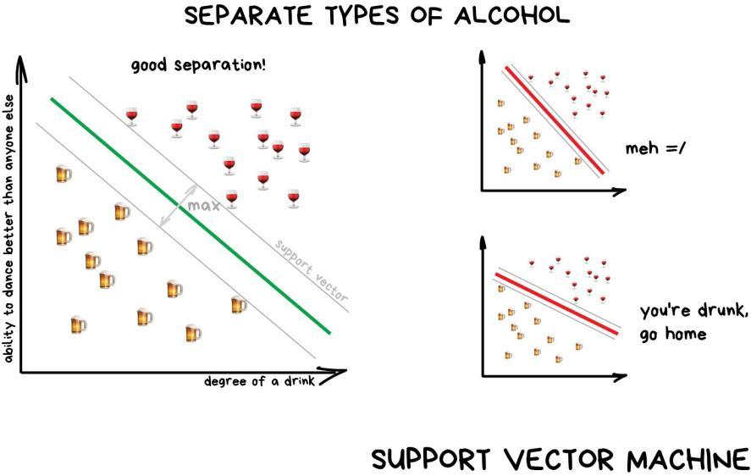
Idea of SVM:
The idea behind SVM is simple – it's trying to draw two lines between your data points with the largest margin between them. Look at the picture:

Slide 30
Idea of SVM:
Train model = build this green line:

Slide 31
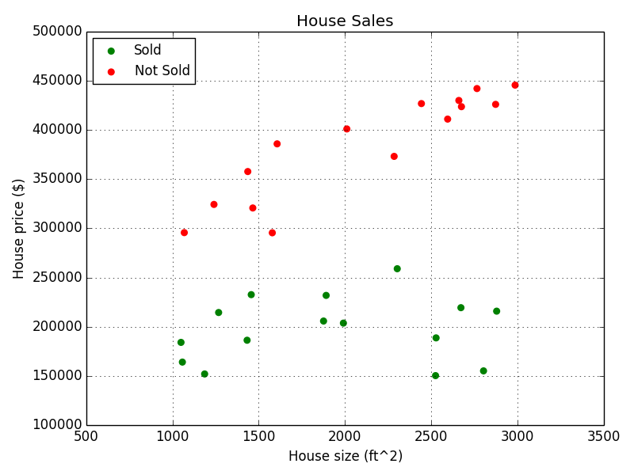
Idea of SVM:
This is ideal situation!

Slide 32
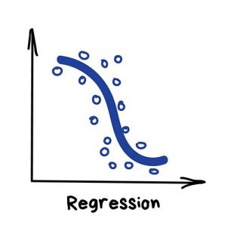
Regression: "Draw a line through these dots. Yep, that's the machine learning"
Examples:
Demand and sales volume analysis
Price of house/car/rent
Traffic by time of the day
Any number-time correlations
Weather forecast

Slide 33
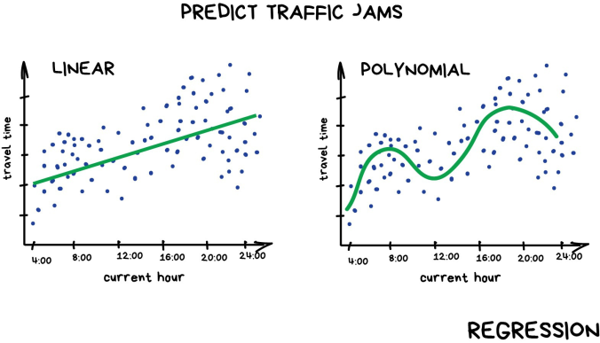
Regression is basically classification where we forecast a number instead of category.
And it's super smooth inside — the machine simply tries to draw a line that indicates average correlation

Slide 34
Regression
Train model = build this green line:

Slide 35
Unsupervised learning
Unsupervised was invented a bit later, in the ‘90s
It's usually useful for exploratory data analysis but not as the main algorithm
Specially trained meatbag with Oxford degree feeds the machine with a ton of garbage and watches it

Slide 36
Clustering - classification with no predefined classes
For market segmentation (types of customers, loyalty)
To analyze and label new data
Searching for similar photos
For image compression
Popular algorithms: K-means_clustering, Mean-Shift, DBSCAN

Slide 37
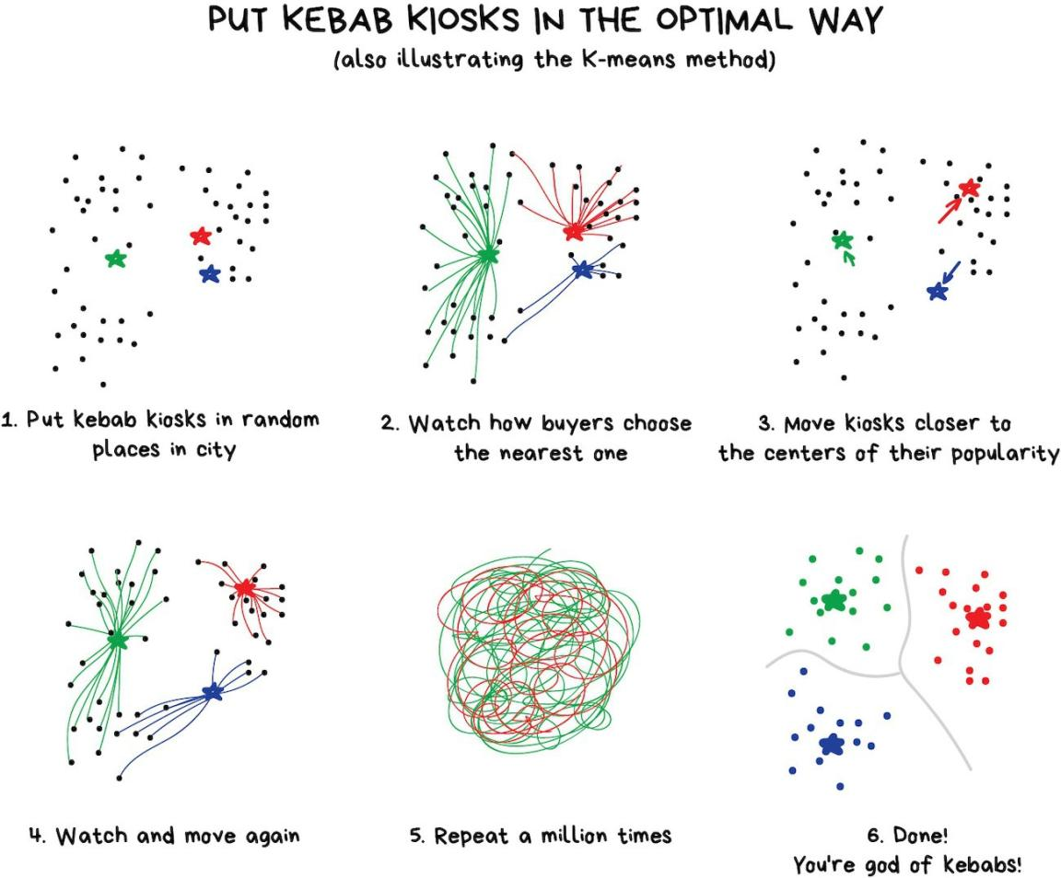
K-Means algotithm

Slide 38
K-Means algotithm
Train model = find these clasters:

Slide 39

DBSCAN
Interested in clustering? Check out this piece The 5 Clustering Algorithms Data Scientists Need to Know

Slide 40
Ensemble Methods: "Bunch of stupid trees learning to correct errors of each other"
Nowadays used for:
Everything that fits classical algorithm approaches (but works better)
Popular algorithms: Random Forest, Gradient Boosting

Slide 41
Ensemble Methods
Ensembles and neural networks are two main fighters. Today they are producing the most accurate results and are widely used in production
Simple idea: If you take a bunch of inefficient algorithms and force them to correct each other's mistakes, the overall quality of a system will be higher than even the best individual algorithms.

Slide 42
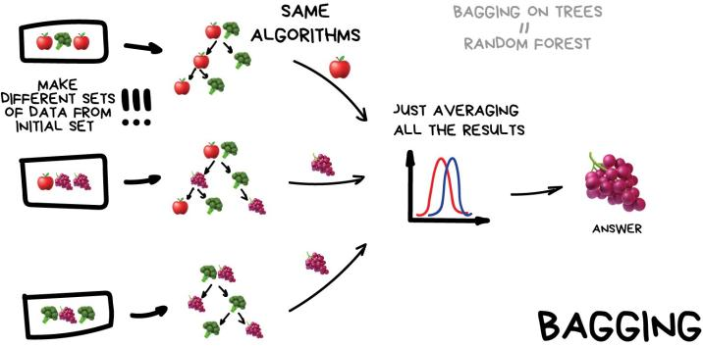
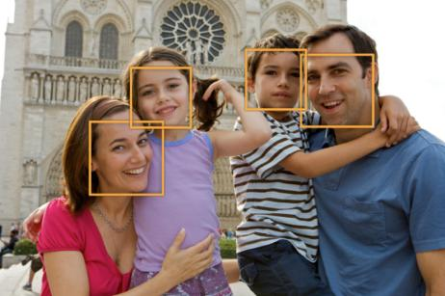
Bagging: Use the same algorithm but train it on different subsets of original data. In the end — just average answers.
Boxes around people's faces on your phone camera — it's probably the results of Random Forest work. Neural networks would be too slow to run real-time

Slide 43
Bagging
Question: Why can’t we train all models on the same dataset?

Slide 44
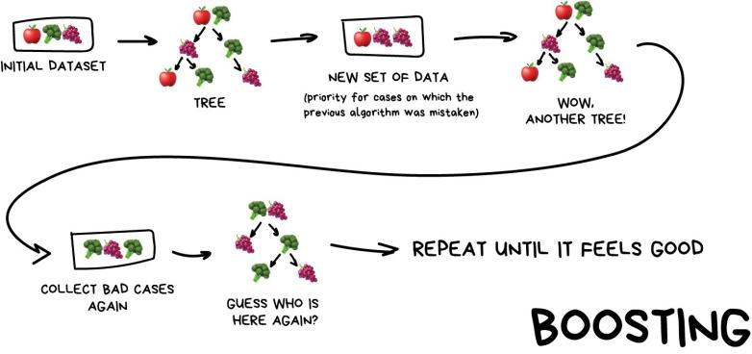
Boosting: Algorithms are trained one by one sequentially. Each subsequent one paying most of its attention to data points that were mispredicted by the previous one. Repeat until you are happy.

Slide 45
Boosting
The main advantage here — a very high, even illegal in some countries precision of classification that all cool kids can envy.
If you want a real example of boosting — open Facebook or Google and start typing in a search query. Can you hear an army of trees roaring and smashing together to sort results by relevancy? That's because they are using boosting.
CatBoost vs. LightGBM vs. XGBoost

Slide 46
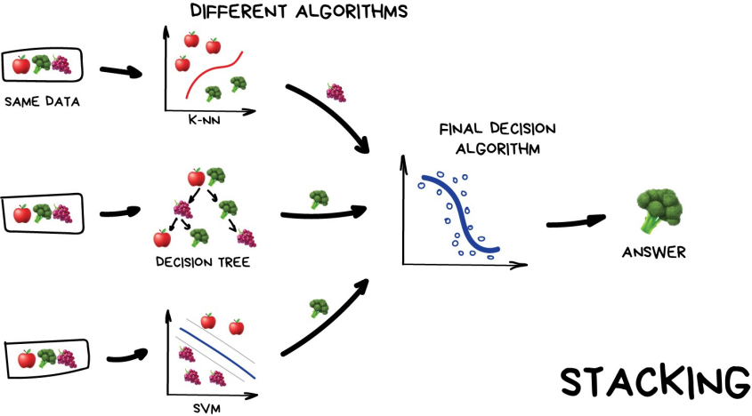
Stacking: you asking your friends for advice and then make your decision
Training session #1: What is Machine Learning?

Slide 47
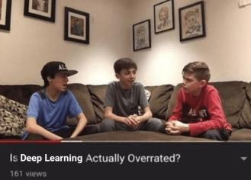
Neural Networks and Deep Leaning: "We have a thousand-layer network, dozens of video cards, but still no idea where to use it. Let's generate cat pics!"
Used today for:
Replacement of all algorithms above
Object identification on photos and videos
Speech recognition and synthesis
Image processing, style transfer
Machine translation

Slide 48
Neural Networks and Deep Leaning:
The rule of thumb is the more complex the data, the more complex the algorithm:
For text, numbers, and tables choose the classical approach. The models are smaller there, they learn faster and work more clearly.
For pictures, video and all other complicated big data things, definitely look at neural networks.

Slide 49
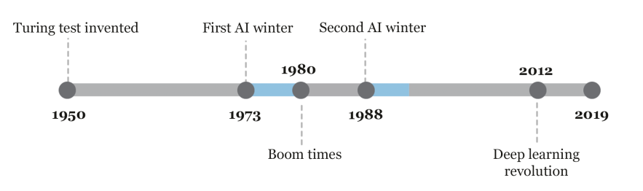
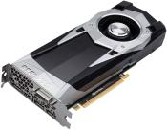
Neural Networks and Deep Leaning:
Unimaginable computation power at that time at 1990’s
Until 2012:
GPU entered the chat

Slide 50
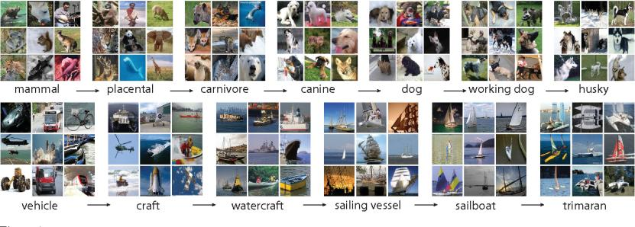
ImageNet competition:
14 197 122 images
21 841 classes
Only dog breeds is 120 classes

Slide 51
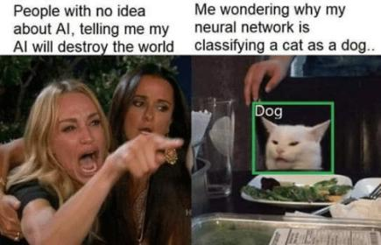
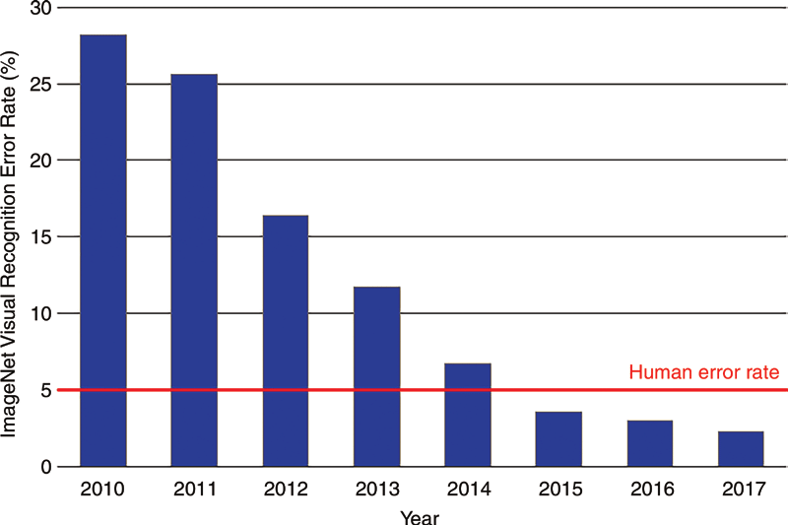

Slide 52
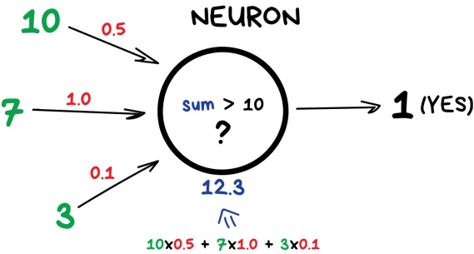
Neuron and Connections:
Neuron is a function with a bunch of inputs and one output. Its task is to take all numbers from its input, perform a function on them and send the result to the output.
Connections are like channels between neurons. They connect outputs of one neuron with the inputs of another so they can send digits to each other. Each connection has only one parameter — weight. It's like a connection strength for a signal. When the number 10 passes through a connection with a weight 0.5 it turns into 5.

Slide 53
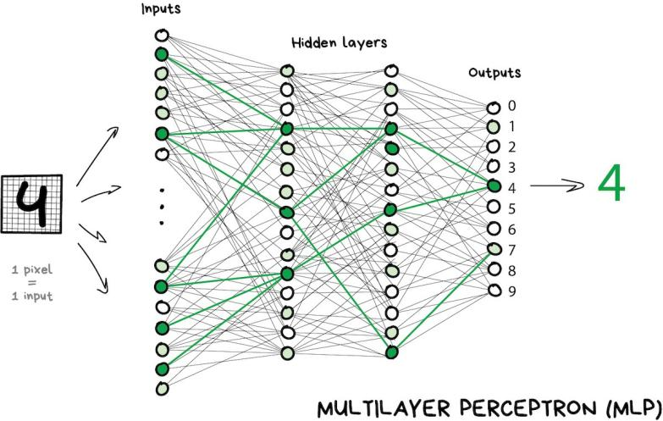
Layers:

Slide 54
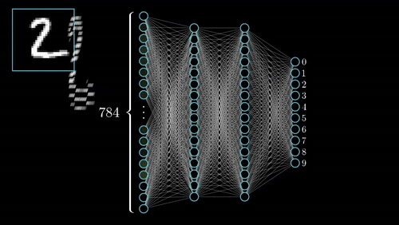

Slide 55
Weights:
How we will assign weights to connections? We have training dataset: samples of 'inputs' and proper 'outputs’!
All weights are assigned randomly
After we show it a digit it emits a random answer because the weights are not correct yet, and we compare how much this result differs from the right one
Then we start traversing network backward from outputs to inputs and tell every neuron 'hey, you did activate here but you did a terrible job and everything went south from here downwards, let's keep less attention to this connection and more of that one, mkay?’
After hundreds of thousands of such cycles of 'infer-check-punish', there is a hope that the weights are corrected and act as intended.

Slide 56
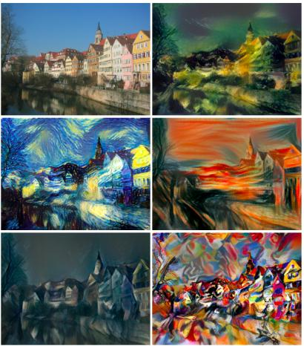
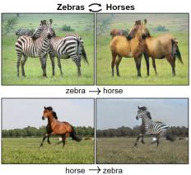
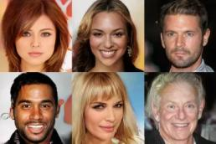
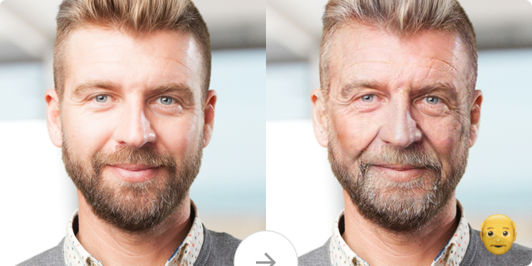
Examples Neural Networks:
Google quick draw: https://quickdraw.withgoogle.com/?locale=en_US#
Google faces: https://teachablemachine.withgoogle.com
https://youtu.be/p1b5aiTrGzY?t=257 (Samsung live portraits)

Slide 57
Reinforcement Learning: "Throw a robot into a maze and let it find an exit”
Nowadays used for:
Games
Self-driving cars
Automating trading
Popular algorithms: Q-Learning, SARSA, DQN, A3C, Genetic algorithm

Slide 58
Reinforcement Learning:
Key idea: Surviving in an environment. Throw poor little robot into real life, punish it for errors and reward it for right deeds. Same way we teach kids
More effective way — сreate a virtual city based on a real map, populate with pedestrians and let the car learn to kill as few people as possible. When the robot is reasonably confident in this artificial GTA, it's free to test in the real streets. Fun!

Slide 59
Examples:
https://www.youtube.com/watch?v=VMp6pq6_QjI (parking)
https://www.youtube.com/watch?v=gn4nRCC9TwQ (DeepMind)
https://youtu.be/L6bbFgjkqK0 (Flappy Bird)
https://www.youtube.com/watch?v=tlOIHko8ySg (boat)
https://en.wikipedia.org/wiki/AlphaGo (Go)
https://en.wikipedia.org/wiki/AlphaZero (Chess)

Slide 60
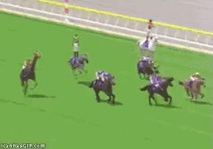
RL agents competition be like:

Slide 61
Summary: what we’ve covered today
Machine Learning is part of AI
Neural networks are part of Machine Learning
Classification (Naïve Bayes, SVM, Decision Tree)
Regression (Linear and Polynomial regressions)
Clustering (k-means, DBSCAN)
Ensemble methods (bagging, boosting, stacking)
Neural Networks: neurons, connections and the idea how to train them
Reinforcement Learning

Slide 62
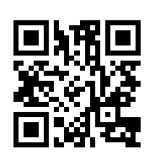
Anonymous feedback:
Link: https://forms.gle/83hW3NYzxD2LzpuF7
Or QR code:

Slide 63
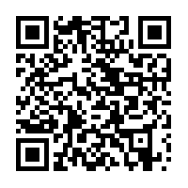
Materials can be found here: https://github.com/DmitriiDenisov/ML_trainings_sessions
Source (Eng): https://vas3k.com/blog/machine_learning/
Source (Rus): https://vas3k.ru/blog/machine_learning/

